Slide 1
WELCOME!
To Mrs. Smith’s 7th Grade Class!

Slide 2

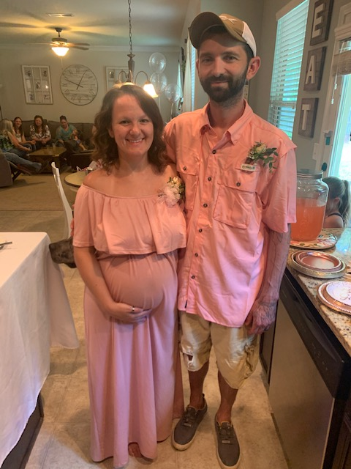
About Me
My name is Taylor Smith, I am married and together we have four boys and two dogs! I am due to have our one and our little girl in September as well!
We have a Great Dane named Tank and a German Short Hair Pointer named Scout!

Slide 3
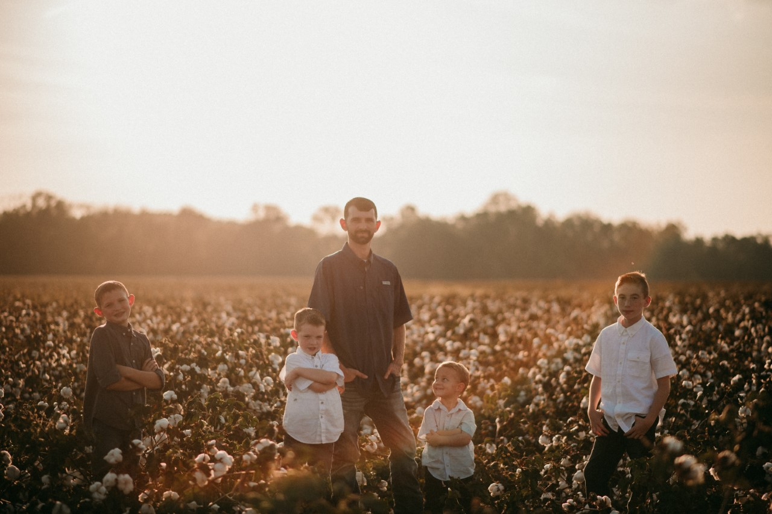
The Boys

Slide 4
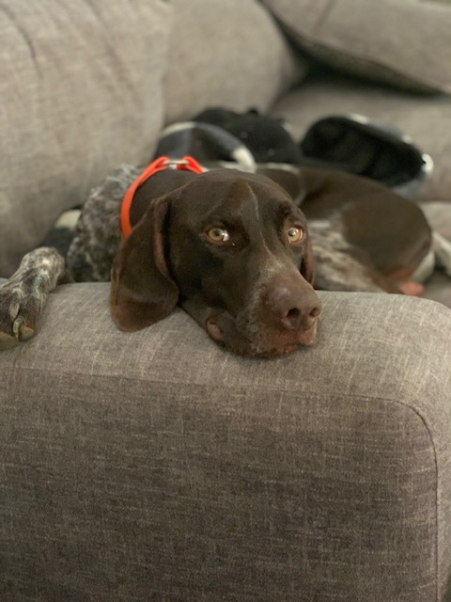
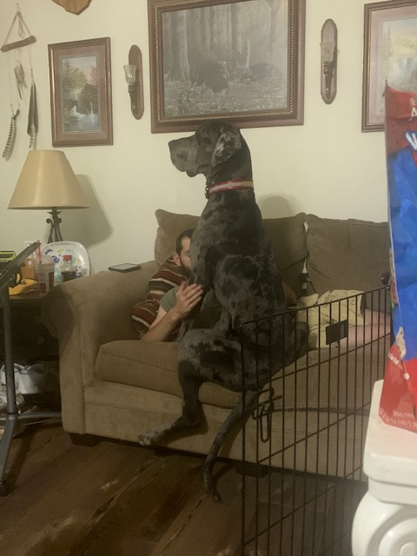
Tank & Scout

Slide 5
Random Facts
I HATE Snakes
I could eat Mexican food every day
My birthday is November 23rd, I was supposed to be born on Thanksgiving in 1991.
I have been to Italy, Germany, France, Bahamas, Mexico, and all around the United States.

Slide 6
Why I Became a Teacher…
Throughout school, I struggled with figuring out the best way to learn for me. Math was the hardest struggle throughout my academic school years. I chose to become a teacher, math teacher specifically, to help students who struggled like I did. I try to find multiple different ways to solve a problem or remember how to solve a problem knowing that ONE way does NOT work for all.

